Slide 1

SpaceSHIP TITANIC
Team – 7
Rafi Baig (RBAIG@KENT.EDU)
Suresh (vdaggupa@kent.edu)
Kavya G (kgandu@kent.edu)
Reference :https://www.quora.com/Would-it-be-possible-to-build-a-spaceship-and-travel-through-a-black-hole-and-see-what-is-on-the-other-side-and-return-to-Earth

Slide 2
Introduction
Spaceship Titanic was an interstellar spaceship that transport people from one planet to other. It has a capacity to carry almost 13,000 passengers.
collided with a spacetime anomaly hidden within a dust cloud. The collision created a disturbance in the orbit and almost half of the passengers transported to an alternate dimension
https://www.kaggle.com/competitions/spaceship-titanic

Slide 3

Project Objectives
to predict which passengers are transported by the anomaly and thus help rescue crews and retrieve passengers using records recovered from the interstellar spaceship’s damaged computer system.
Statistically, this task follows classification problem and here we will be implementing various classification techniques and compare their performance results.
Performance evaluation will be based on Classification Accuracy.

Slide 4
STAKEHOLDER
Sourav Redwanul Haque is a Ph.D. Candidate in computer science department. Sourav worked in Samsung Research & Development institute and expert in Machine Learning also good in C++ development. Currently he is working as Teaching Assistant in Kent State University.
Email: rsourave@kent.edu
LinkedIN : https://www.linkedin.com/in/redwanulsourav
END User
Regarding this task, this prediction will help the rescue crews and can bring back the lost passengers. Considering this fact, we can say that our end users for this challenge is ship crew.

Slide 5
Constraints imposed by customer
Project needs to have an implementation with python version >=3.7 using any of the IDE’s.
Statistical analysis to analyze the insights of data.
Modelling Techniques should be advanced.
Weekly Report status about the project for updates and changes if required.
Compare different modelling techniques with its performance results.
Good UI for presentation.

Slide 6
Assumptions & Risks
We assume that the data each passenger has ID, and it is unique for each passenger.
Data may contain outliers which needs to be cleaned.
Also, it might contain some duplicate values which need more evaluation and analysis.
Modelling will have chances for the overfitting.
Tools & Framework
Anaconda Navigator or PyCharm Express.
Language: Python & JavaScript
Framework : React Js

Slide 7
Literature Review
Note: Spaceship Titanic is a cosmic mystery and unseen future, typical hypothetical situation and It is a classification problem. For literature review we are analyzing improvised classification techniques considering references from the research papers.
1. Classification Based on Decision Tree Algorithm for Machine Learning (Journal of Applied Science & Technology Trends -2021)
2. PERFORMANCE OF RIDGE LOGISTIC REGRESSION AND DECISION TREE IN THE BINARY CLASSIFICATION (Journal of Theoretical and Applied Information Technology – 15th Aug 2022)
3. XGBoost and Deep Neural Network Comparison: The Case of Teams’ Performance (International Conference on Intelligent Tutoring Systems)
We aimed at classification techniques that has significant performance results in the above papers.
The referred papers uses ridge logistic regression and decision tree modeling techniques on a dataset that has all features of binary categorical scale.

Slide 8
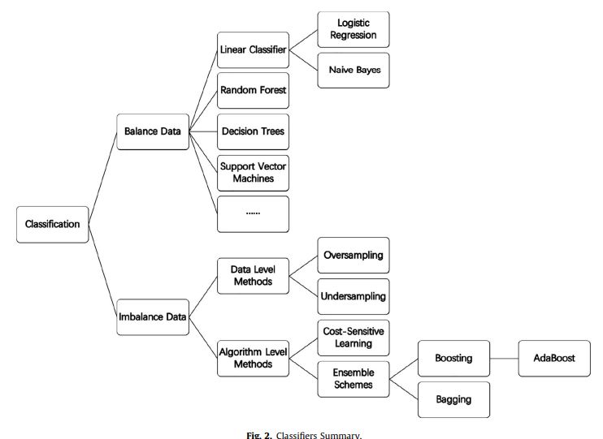
Classifiers

Slide 9
Extra Tree classifier:
For Imbalanced Data --- X ( since it effects entropy or Gini Calculation)
The trick here is to perform Up-Sampling or Down-Sampling or Class-Weight Calculations
Large Dimensions --- X ( since each node splits ---evaluate each feature i.e., Information Gain/ entropy).
Similarity Matrix ? D.T cannot work in such cases . ( Similarity matrix needs the feature explicitly since it cannot compute entropy)
Multi-class classification – It can easily perform multiclass classification. One Vs Rest.
Entropy can be calculated for Multiple categories; It is not limited to two. It naturally occurs for Multi-Class classification.
Decision surface – We get non-linear, axis parallel, hyper cuboids and each of node has hyperplane.
Feature Interaction – feature depends on each other

Slide 10
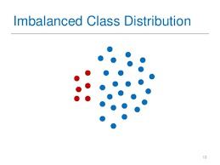
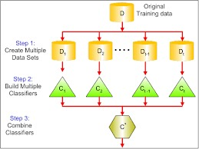

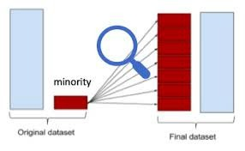
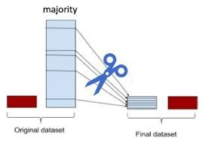

Slide 11
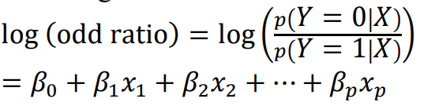
Ridge Logistic Regression
Logistic regression is a linear classification model that performs very satisfactorily for the classification of linearly separable binary class data sets
Regularization of L2 norm and tree pruning is intended to handle an over-fitting problem.
The equation is a linear combination between predictor features and associated weights.
the problem is solved by maximizing likelihood function

Slide 12
Performance scores of Referred papers
The results showed that DT efficiency is higher than RF, achieving 84.11 % with DT accuracy, while 58.11 % with RF accuracy[1].
The KNN classification is better than the DT classification in the PCA feature extraction. The accuracy of KNN reaches 86.7% while the DT reaches 83.3%[1].
They achieved accuracy score of 84% using Ridge logistic regression and 81% using decision tree [2].
Predication accuracy of XGBOOST and DNN was found to be 80.50% and 77.36%.

Slide 13
LR – Cases:
Decision surface – Linear surface → since it is a hyperplane.
(Assume data is linearly separable or almost linearly separable)
Feature Importance & Interpretability – |Wi| vector,
features are not muti-collinear – LR will work fine
if it is collinear → we use forward feature selection
Imbalance data → Up sampling & Down Sampling
Outliers → less impact → due to sigmoid function

Slide 14
References
https://www.jastt.org/index.php/jasttpath/article/download/65/24
https://www.researchgate.net/profile/Samingun-Handoyo/publication/362694090_PERFORMANCE_OF_RIDGE_LOGISTIC_REGRESSION_AND_DECISION_TREE_IN_THE_BINARY_CLASSIFICATION/links/62f9bf61c6f6732999cfae38/PERFORMANCE-OF-RIDGE-LOGISTIC-REGRESSION-AND-DECISION-TREE-IN-THE-BINARY-CLASSIFICATION.pdf
https://link.springer.com/chapter/10.1007/978-3-030-80421-3_37

Slide 15
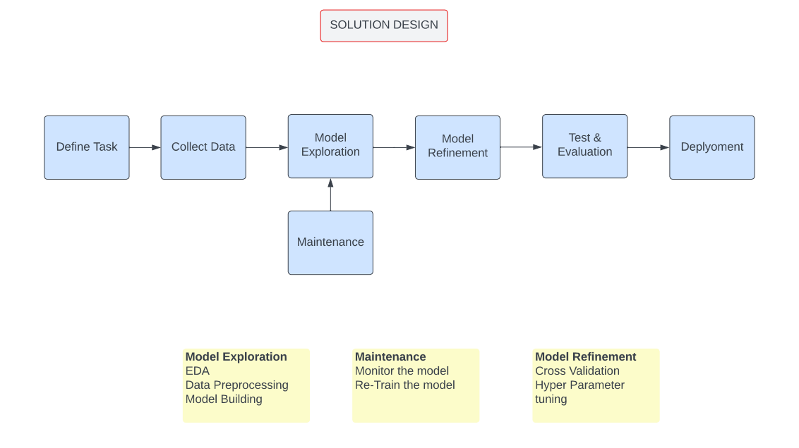
Methodology

Slide 16
Extra Tree Classifier
Each decision stump will be built with the following criteria:
All the data available in the training set is used to build each stump.
To form the root node or any node, the best split is determined by searching in all the available features.
The maximum depth of the decision stump is one.
Random Forests
A bootstrap will be created by randomly sampling the training set with replacement. The size of the bootstrap is set to equal the size of the training set.
To form the root node or any node, the best split is determined by searching in a subset of randomly selected features of size sqrt(number of features). In our case, each decision stump is allowed to inspect two out of the four features.
The maximum depth of the decision stump is one

Slide 17
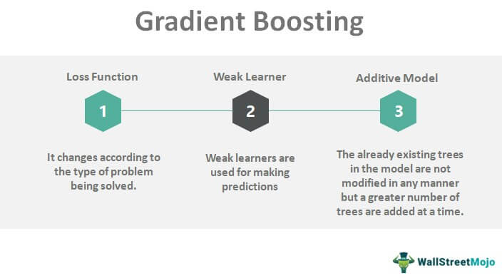
Gradient boosting
A big insight into bagging ensembles and random forest was allowing trees to be greedily created from subsamples of the training dataset.
This same benefit can be used to reduce the correlation between the trees in the sequence in gradient boosting models.

Slide 18
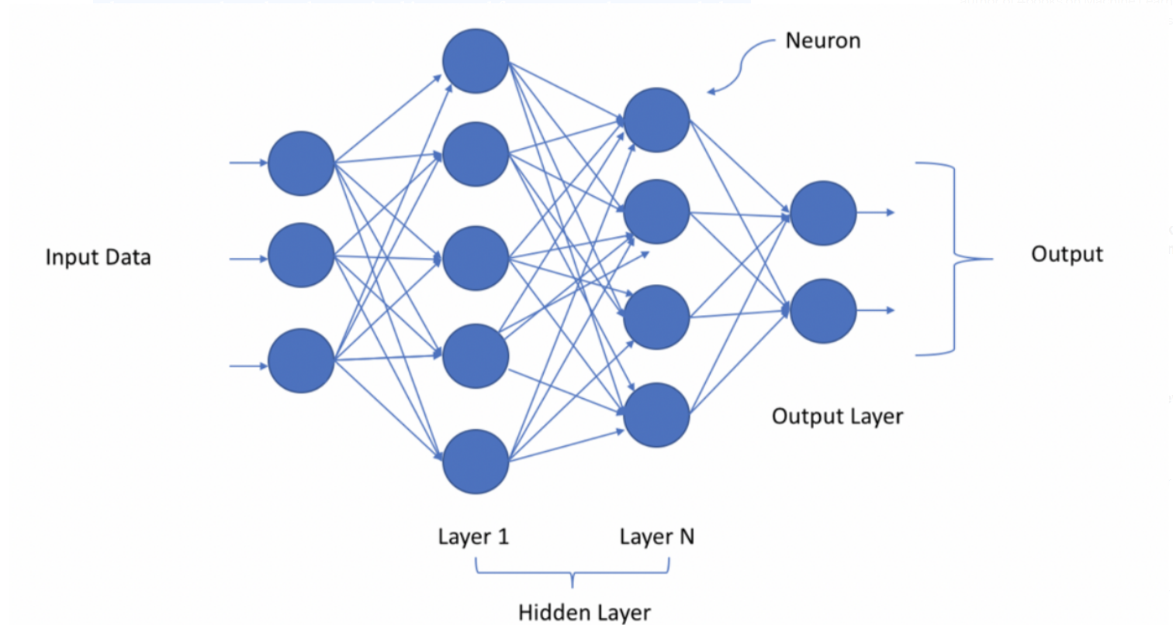
Deep Neural networks

Slide 19
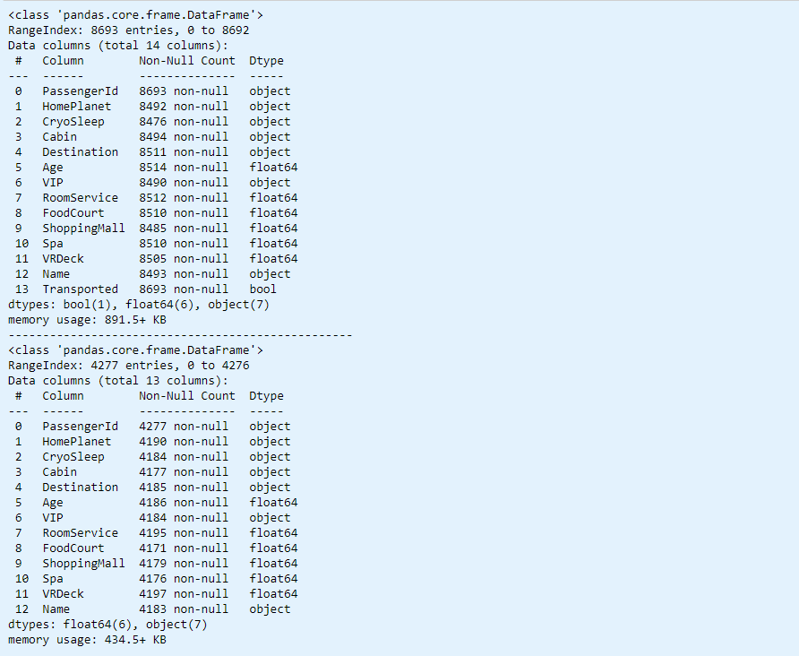
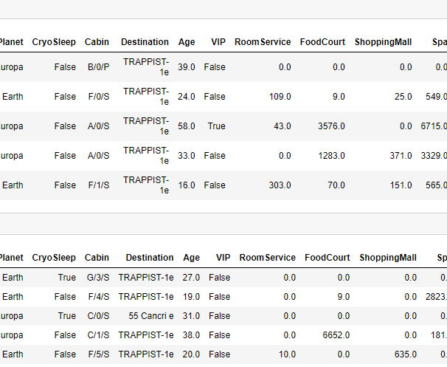
Data Analysis
data.info
data.head

Slide 20
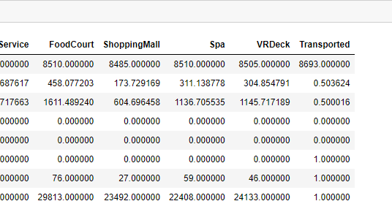
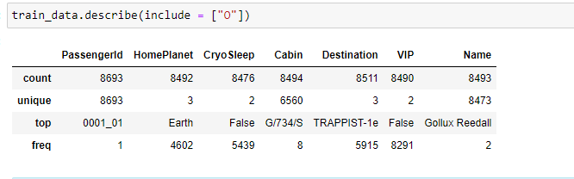
Statistical Information of earth & All together:

Slide 21
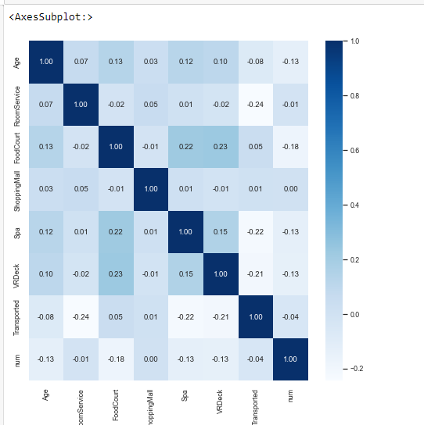
HeatMap

Slide 22
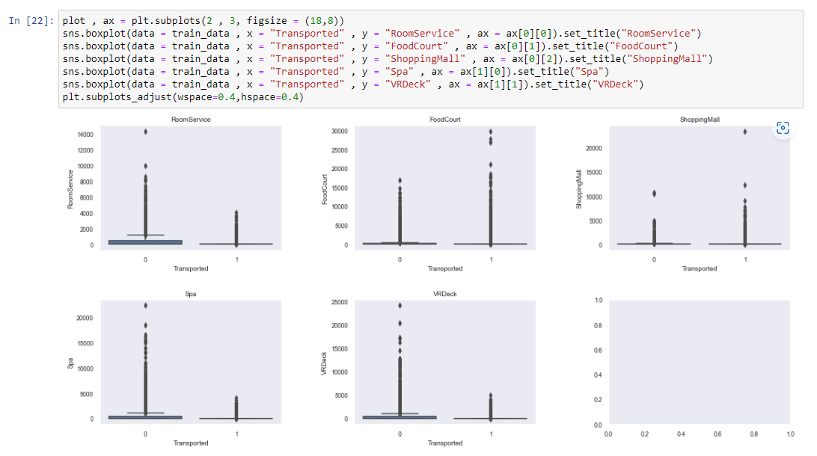
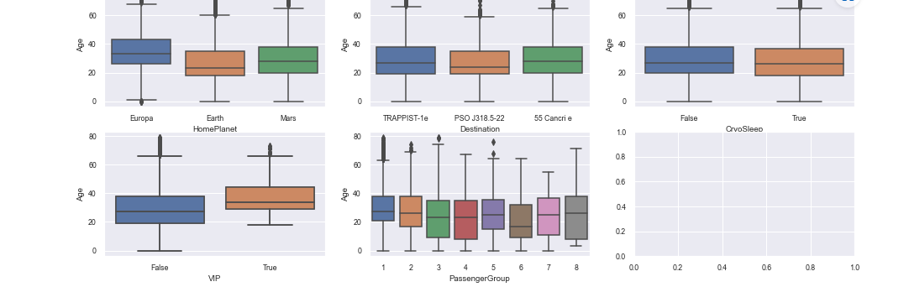
Plots for Outliers

Slide 23
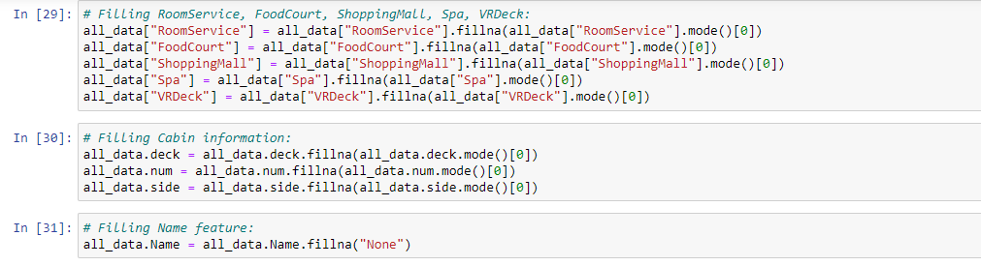
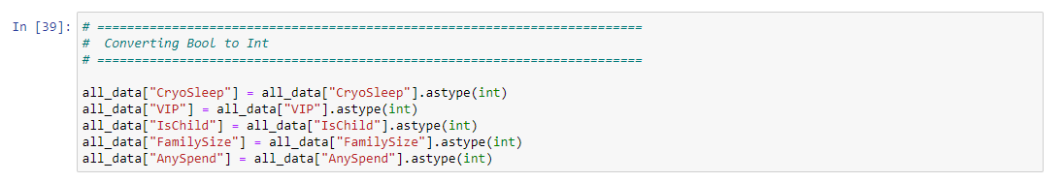
Feature Engineering

Slide 24
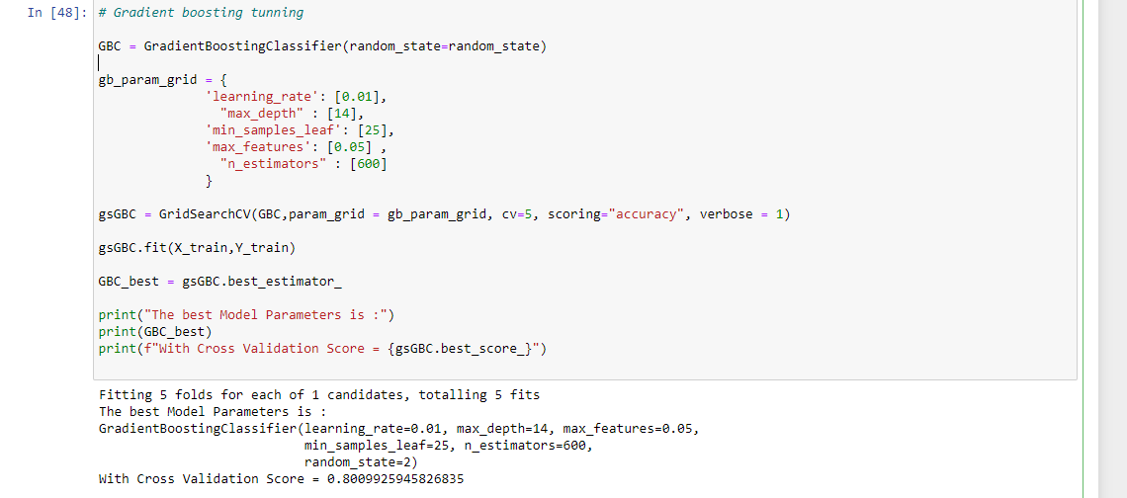
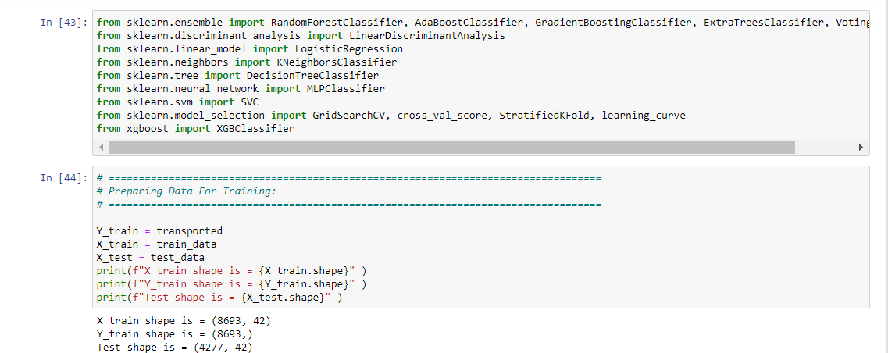
Modelling

Slide 25
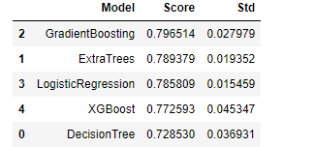
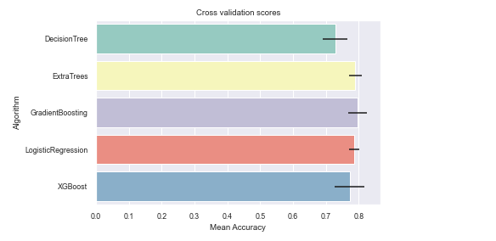
Results

Slide 26
Insights
Our approach achieved score of 79.6 (mean accuracy).
We are trying to achieves score of more than 80 percent.
Implement GUI.

